Slide 1
Models of Network Formation

Slide 2
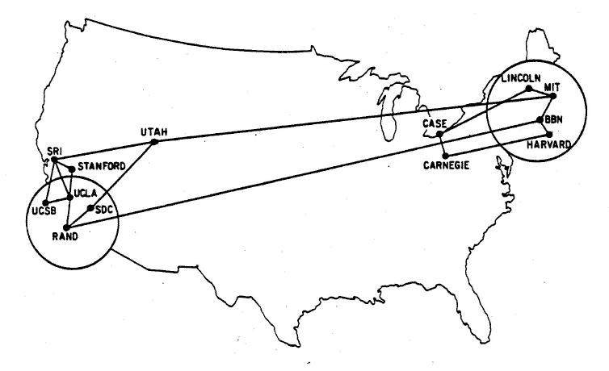
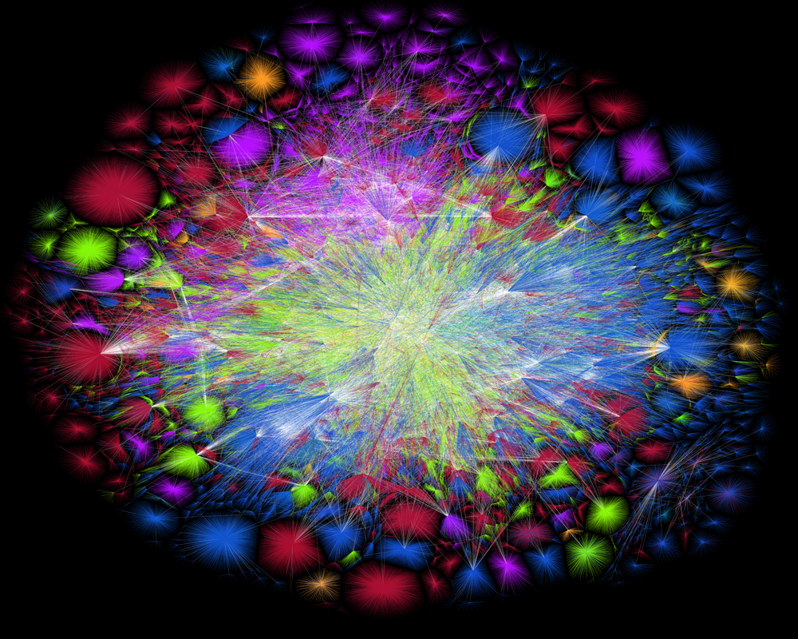
Power Laws and Network Formation
Question. Why are real-world networks with power-law degree distributions so widespread?
Answer. A key idea for a possible explanation is to consider the process of formation of a network. For example, how did a small network of 13 computers turn into the Internet?

Slide 3
We consider two models that form networks with power-law degree distribution:
Preferential attachment
There are two close variants of this model:
the variant for directed networks was proposed by Price in 1976;
the variant for undirected networks was proposed by Barabási and Albert in 1999.
Copying model
The original variant for directed networks (inspired by evolution of the Web) was proposed by Kleinberg with co-authors in 1999.

Slide 4
Preferential attachment

Slide 5
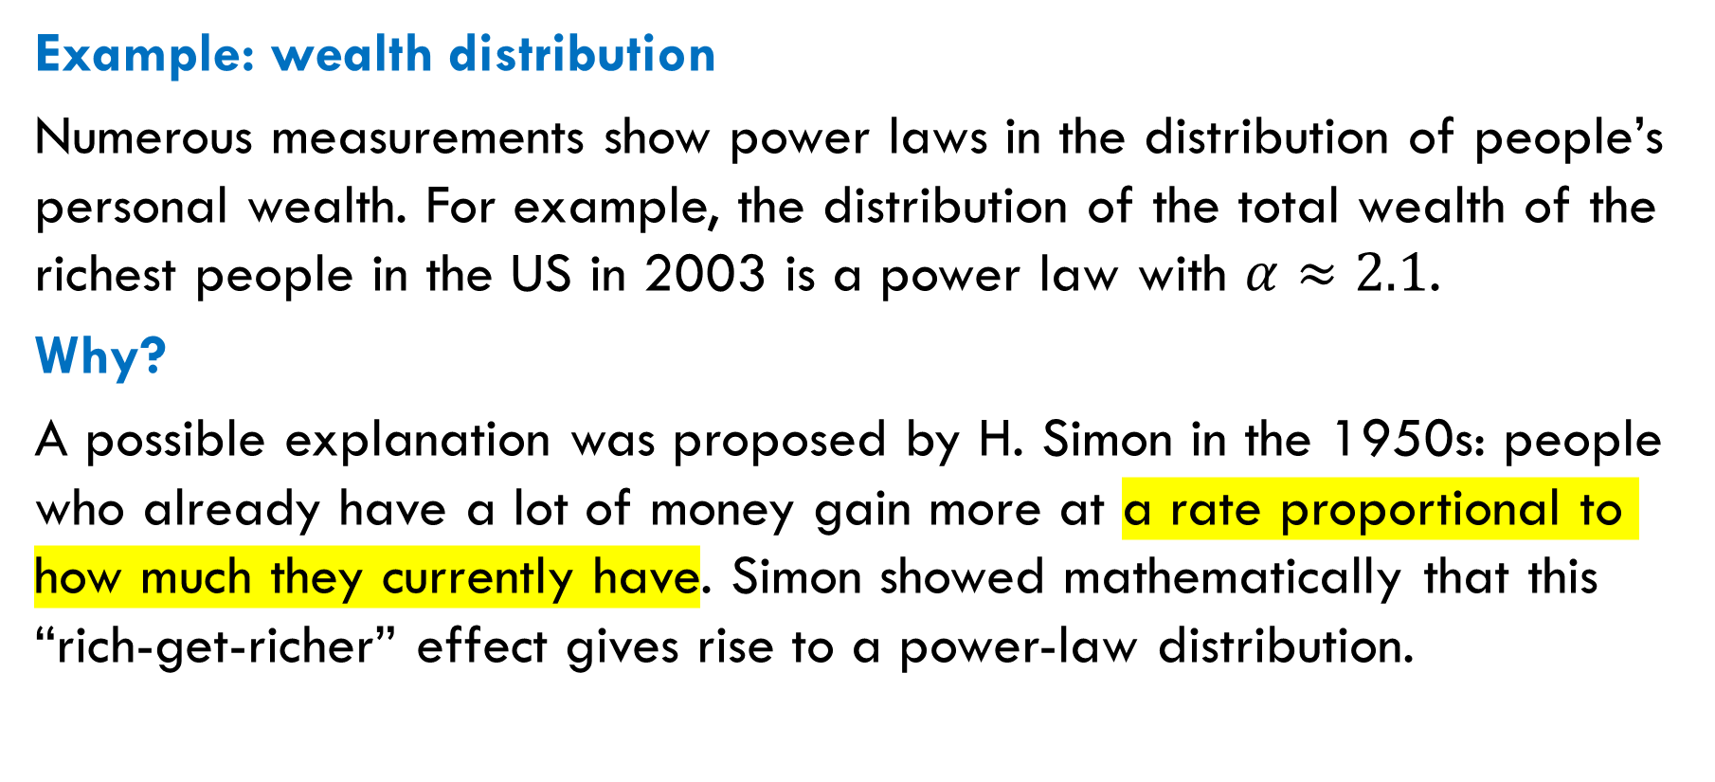
Power Laws in Non-Network Data
Example: wealth distribution
Numerous measurements show power laws in the distribution of people’s personal wealth. For example, the distribution of the total wealth of the richest people in the US in 2003 is a power law with $α≈2.1$.
Why?
A possible explanation was proposed by H. Simon in the 1950s: people who already have a lot of money gain more at a rate proportional to how much they currently have. Simon showed mathematically that this “rich-get-richer” effect gives rise to a power-law distribution.

Slide 6
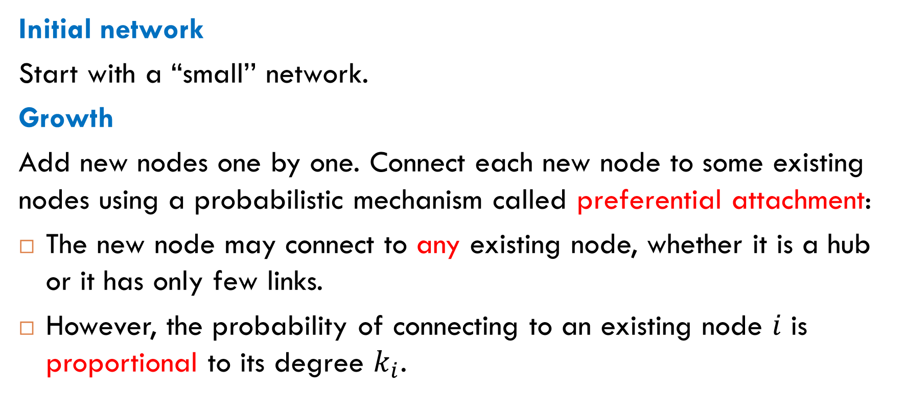
The Barabási-Albert Model (Informally)
Initial network
Start with a “small’’ network.
Growth
Add new nodes one by one. Connect each new node to some existing nodes using a probabilistic mechanism called preferential attachment:
The new node may connect to any existing node, whether it is a hub or it has only few links.
However, the probability of connecting to an existing node $i$ is proportional to its degree $k_{i}$.

Slide 7
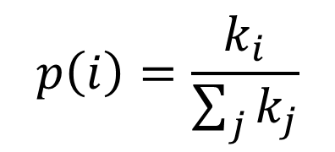
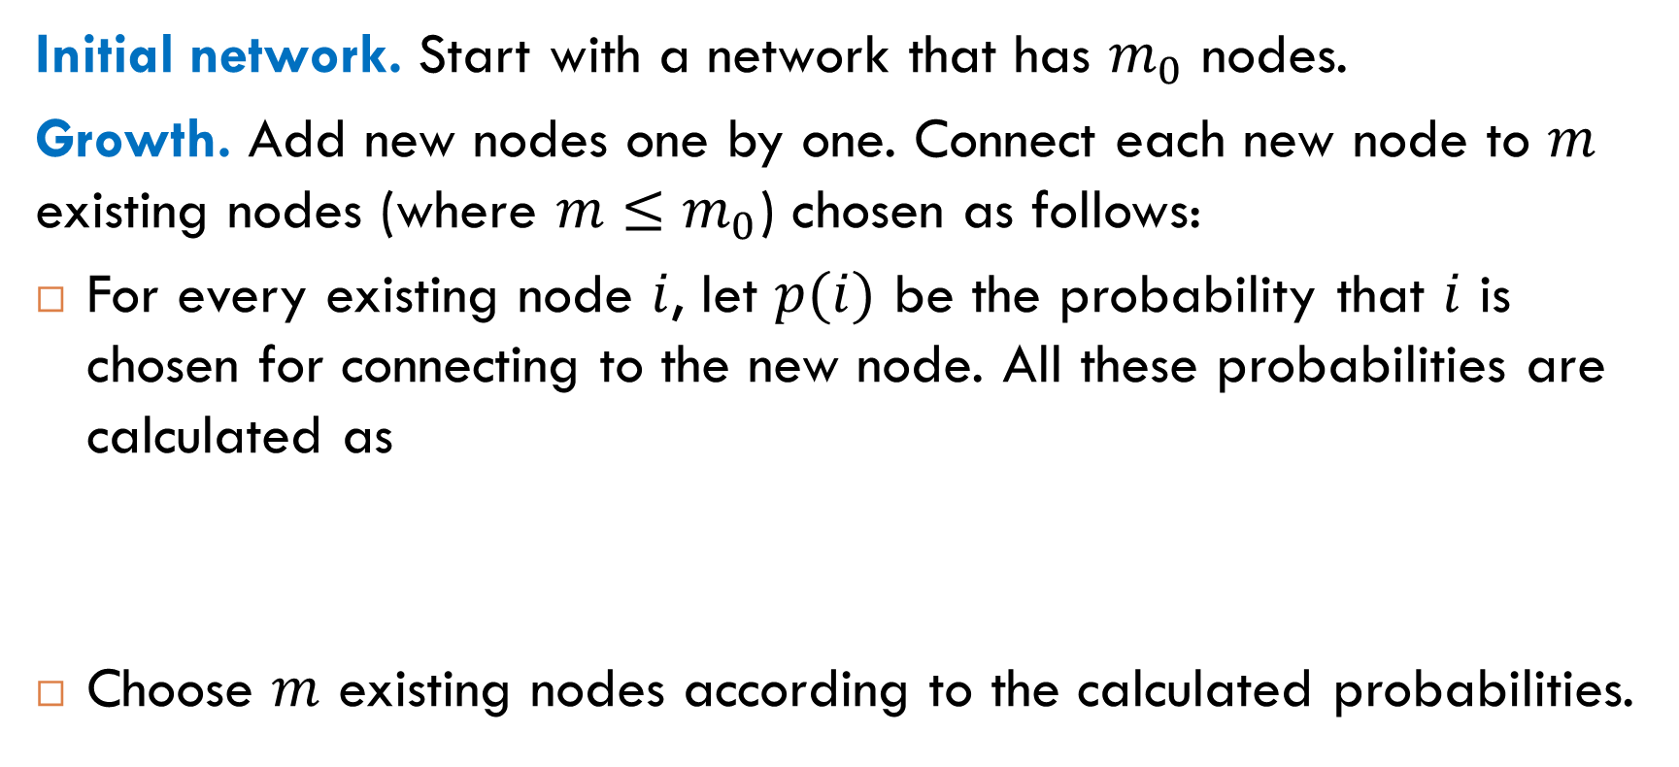
The Barabási-Albert Model (More Formally)
Initial network. Start with a network that has $m_{0}$ nodes.
Growth. Add new nodes one by one. Connect each new node to $m$ existing nodes (where $m≤m_{0}$) chosen as follows:
For every existing node $i$, let $p(i)$ be the probability that $i$ is chosen for connecting to the new node. All these probabilities are calculated as
Choose $m$ existing nodes according to the calculated probabilities.
$$p\left(i\right)=\frac{k_{i}}{\sum_{j}{k_{j}}}$$

Slide 8
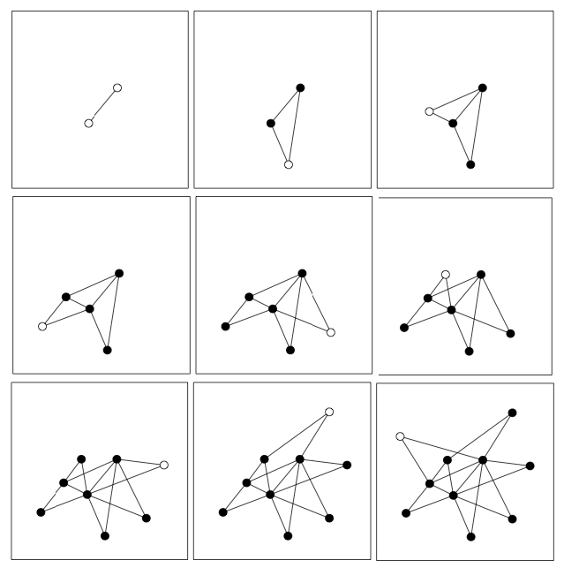
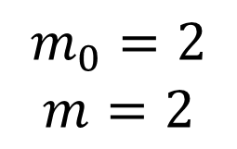
Example
$$m_{0}=2$$
$$m=2$$
http://networksciencebook.com/chapter/5#barabasi-model

Slide 9
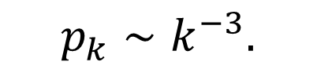
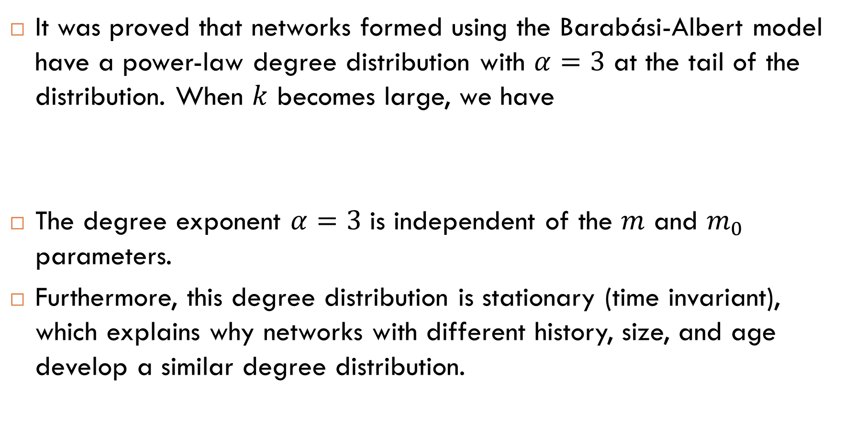
Power-Law Degree Distribution
It was proved that networks formed using the Barabási-Albert model have a power-law degree distribution with $α=3$ at the tail of the distribution. When $k$ becomes large, we have
The degree exponent $α=3$ is independent of the $m$ and $m_{0}$ parameters.
Furthermore, this degree distribution is stationary (time invariant), which explains why networks with different history, size, and age develop a similar degree distribution.
$$p_{k}∼k^{−3}.$$

Slide 10
Why Do the Rich Get Richer?
Amplification effect
In preferential attachment models, node degrees increase at a rate proportional to their current degrees. Therefore, a node that gets a small lead over others will tend to extend this lead.
many hubs, a long tail
an aphorism attributed to Percy Bysshe Shelley (1792-1822), one of the major English Romantic poets.
“The rich get richer and the poor get poorer.”

Slide 11
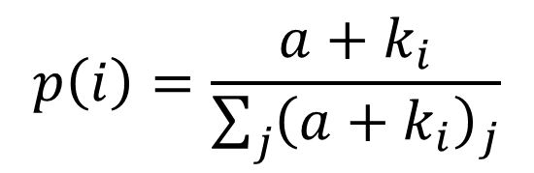
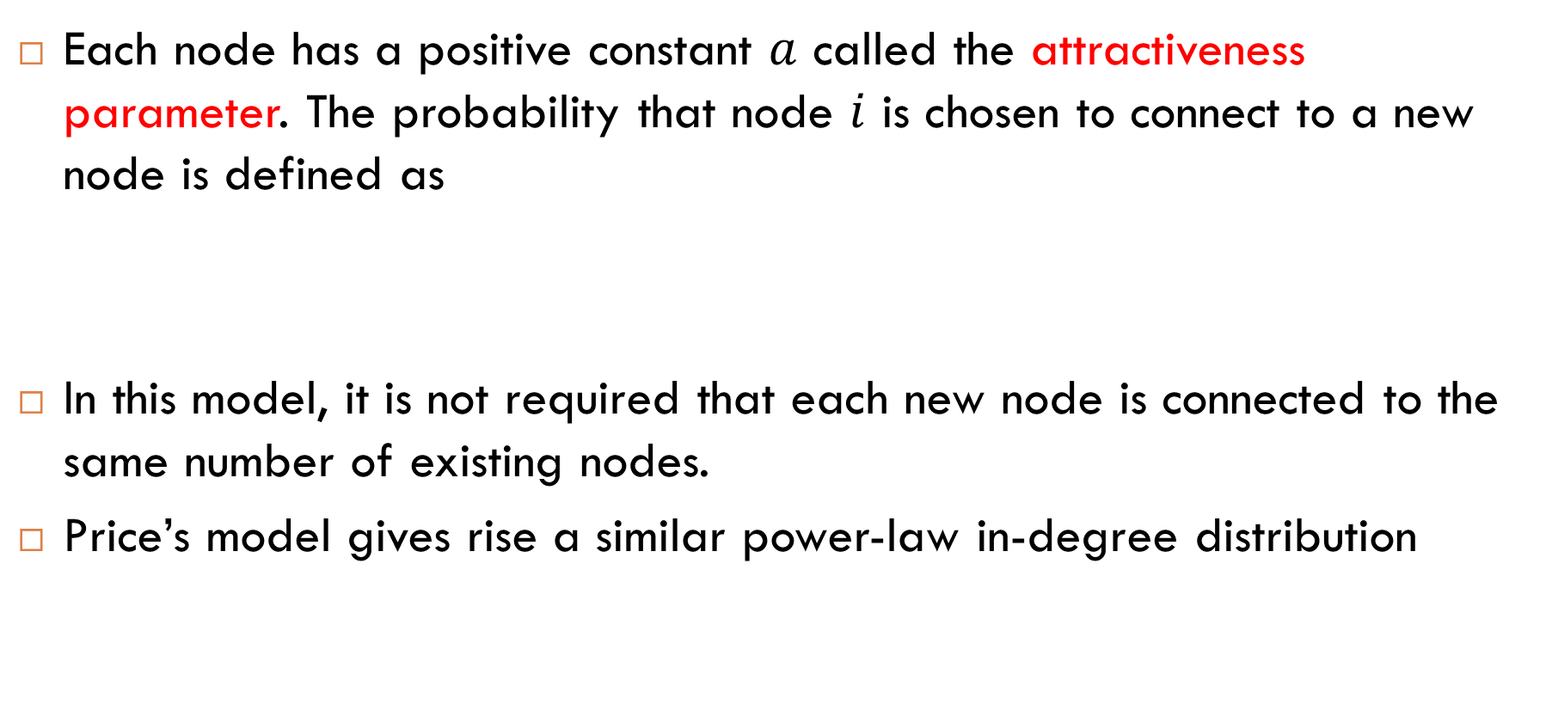
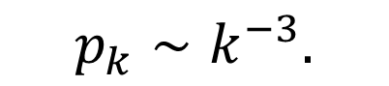
Price’s Model
Each node has a positive constant $a$ called the attractiveness parameter. The probability that node $i$ is chosen to connect to a new node is defined as
In this model, it is not required that each new node is connected to the same number of existing nodes.
Price’s model gives rise a similar power-law in-degree distribution
$$p\left(i\right)=\frac{a+k_{i}}{\sum_{j}{{\left(a+k_{i}\right)}_{j}}}$$
$$p_{k}∼k^{−3}.$$

Slide 12
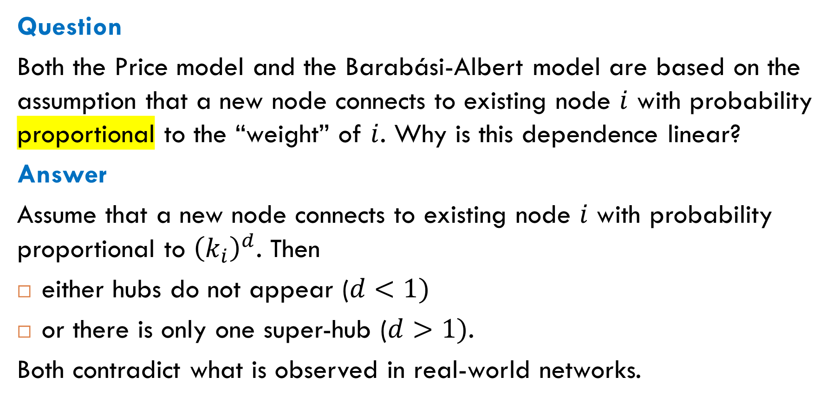
Non-Linear Preferential Attachment
Question
Both the Price model and the Barabási-Albert model are based on the assumption that a new node connects to existing node $i$ with probability proportional to the “weight” of $i$. Why is this dependence linear?
Answer
Assume that a new node connects to existing node $i$ with probability proportional to ${\left(k_{i}\right)}^{d}$. Then
either hubs do not appear ($d<1)$
or there is only one super-hub ($d>1)$.
Both contradict what is observed in real-world networks.

Slide 13
Is the Assumption Reasonable?
Question
Preferential attachment models assume that an existing node is chosen for connecting to a new node with probability proportional to its current degree. Is this assumption reasonable?
Answer
The assumption makes sense for networks where the degree of a node can be viewed as a measure of the node’s popularity.
It is not obvious why the assumption can hold for technological or biological networks. There are other models of network formation that give rise for power laws in such networks.

Slide 14
Copying Models
Duplication with Mutation

Slide 15
Another Approach
Idea
As in preferential attachment models, we build a network step by step, beginning with a small initial network. At each step, a new node connects to some existing nodes.
What is the difference? Instead of connecting to highest-weight nodes, each new node connects to the nodes chosen by one of the earlier nodes. That is, we copy (with slight changes) the links created by one of the earlier nodes.
This mechanism, duplication with mutation, is observed in certain biological networks, see section 13.5 in Newman’s book.

Slide 16
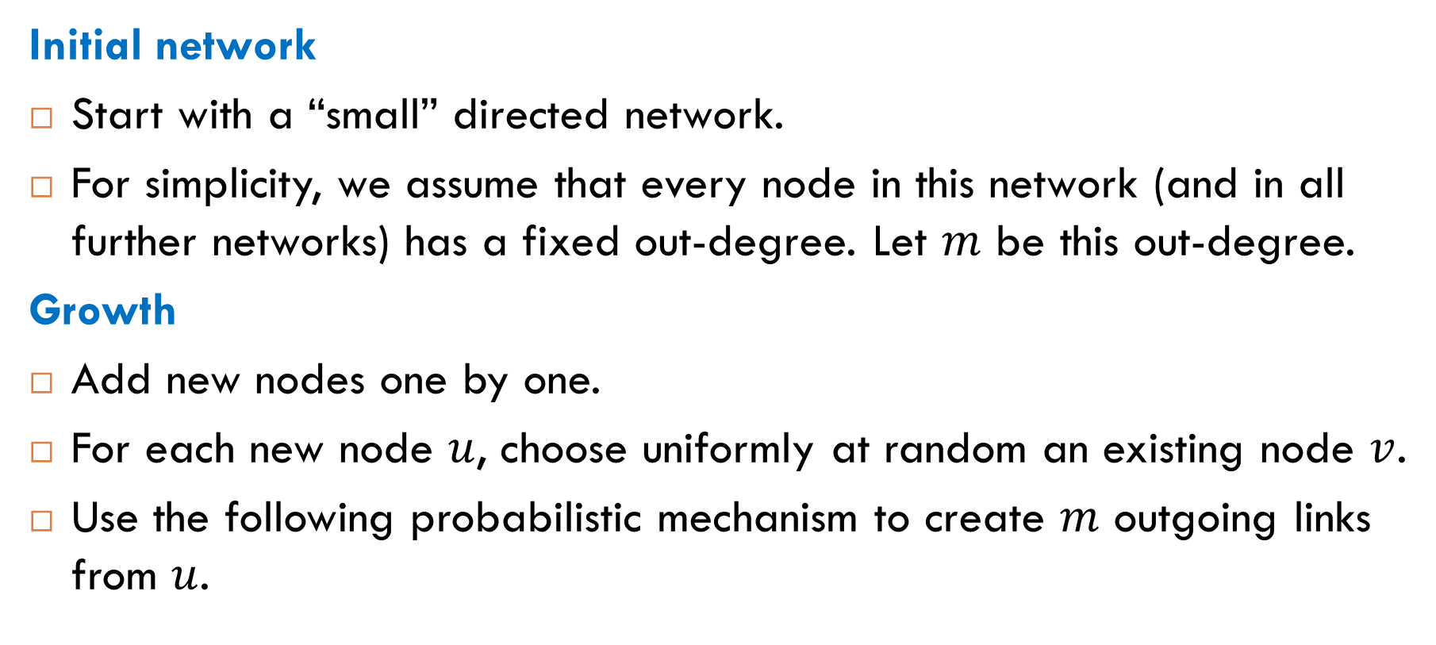
The Copying Model
Initial network
Start with a “small” directed network.
For simplicity, we assume that every node in this network (and in all further networks) has a fixed out-degree. Let $m$ be this out-degree.
Growth
Add new nodes one by one.
For each new node $u$, choose uniformly at random an existing node $v$.
Use the following probabilistic mechanism to create $m$ outgoing links from $u$.

Slide 17
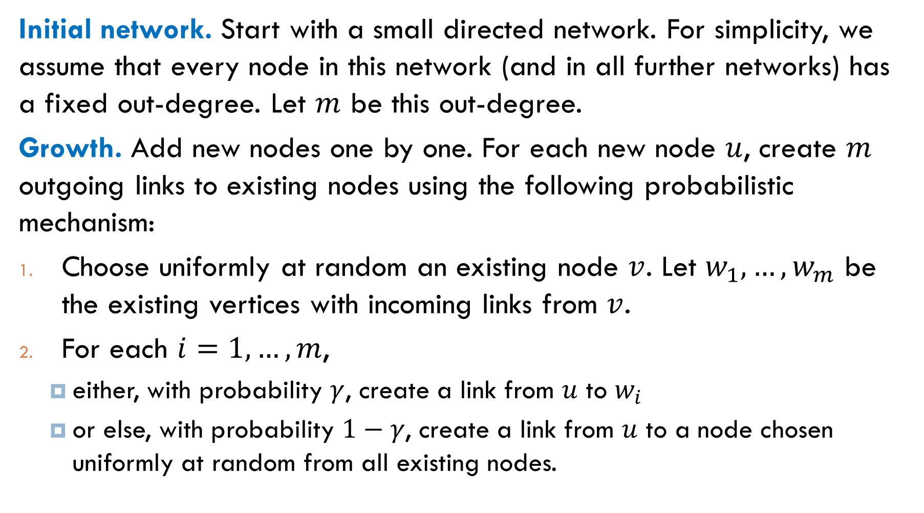
Initial network. Start with a small directed network. For simplicity, we assume that every node in this network (and in all further networks) has a fixed out-degree. Let $m$ be this out-degree.
Growth. Add new nodes one by one. For each new node $u$, create $m$ outgoing links to existing nodes using the following probabilistic mechanism:
Choose uniformly at random an existing node $v$. Let $w_{1},…, w_{m}$ be the existing vertices with incoming links from $v$.
For each $i=1, …, m$,
either, with probability $γ$, create a link from $u$ to $w_{i}$
or else, with probability $1−γ$, create a link from $u$ to a node chosen uniformly at random from all existing nodes.

Slide 18
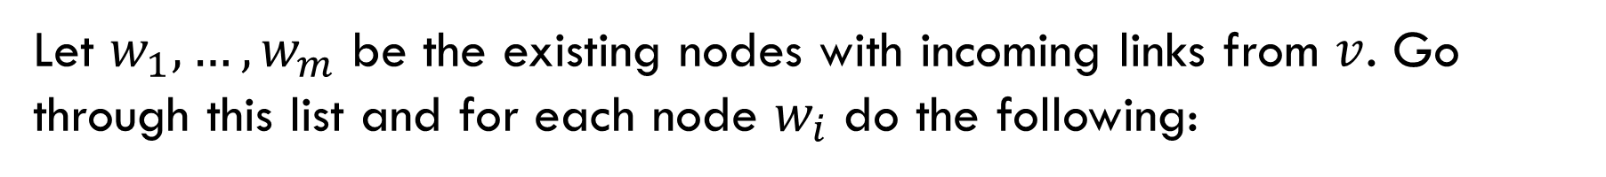
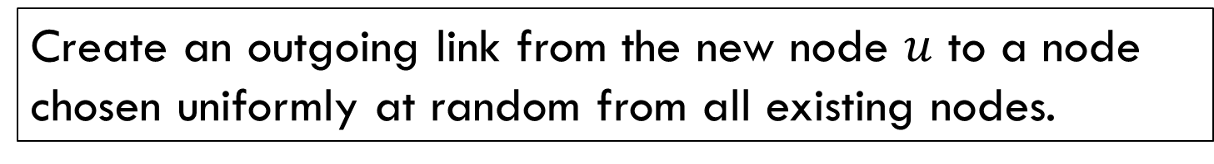
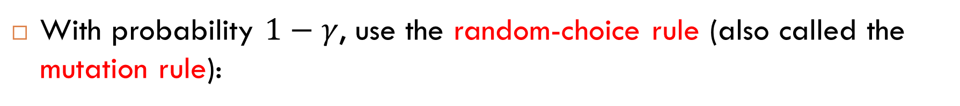
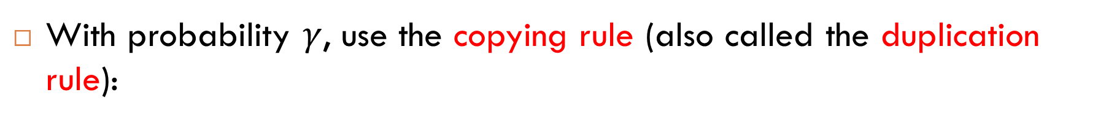
Probabilistic Mechanism
Let $w_{1},…, w_{m}$ be the existing nodes with incoming links from $v$. Go through this list and for each node $w_{i}$ do the following:
With probability $γ$, use the copying rule (also called the duplication rule):
Create an outgoing link from the new node $u$ to $w_{i}$.
With probability $1−γ$, use the random-choice rule (also called the mutation rule):
Create an outgoing link from the new node $u$ to a node chosen uniformly at random from all existing nodes.

Slide 19
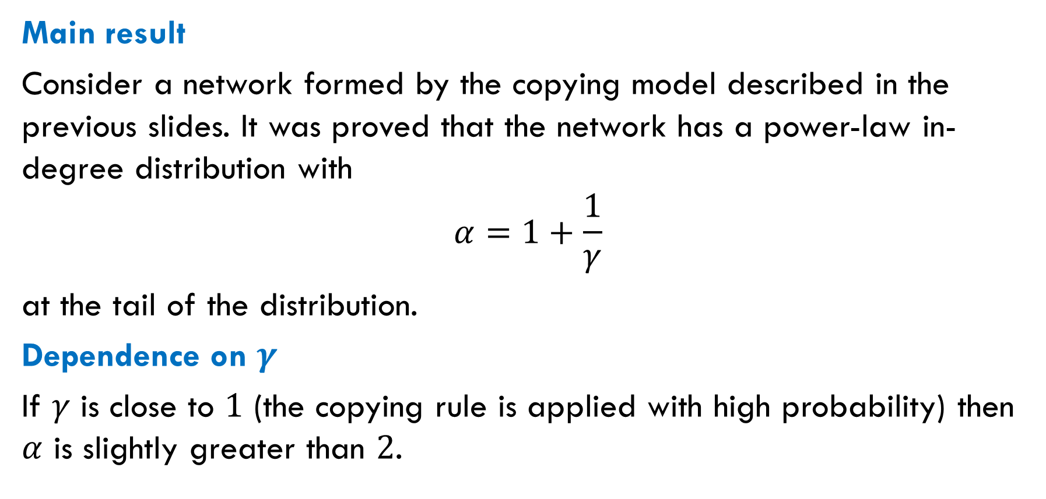
Power Laws for the Copying Model
Main result
Consider a network formed by the copying model described in the previous slides. It was proved that the network has a power-law in-degree distribution with
$$α=1+\frac{1}{γ}$$
at the tail of the distribution.
Dependence on $γ$
If $γ$ is close to $1$ (the copying rule is applied with high probability) then $α$ is slightly greater than $2$.

Slide 20
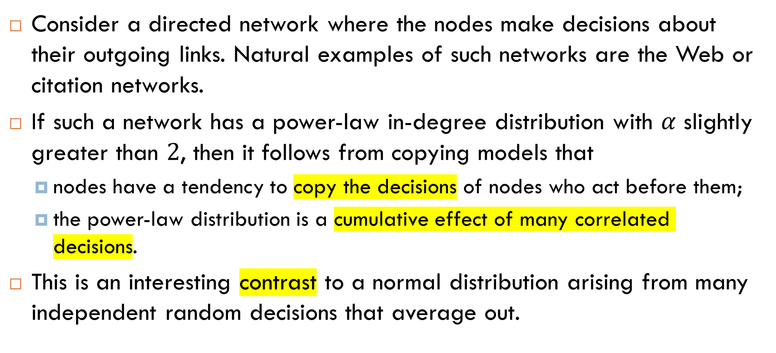
Making Decisions
Consider a directed network where the nodes make decisions about their outgoing links. Natural examples of such networks are the Web or citation networks.
If such a network has a power-law in-degree distribution with $α$ slightly greater than $2$, then it follows from copying models that
nodes have a tendency to copy the decisions of nodes who act before them;
the power-law distribution is a cumulative effect of many correlated decisions.
This is an interesting contrast to a normal distribution arising from many independent random decisions that average out.

Slide 21
Bell Curves Versus Power Laws
Normal distributions. Why do they turn up?
Underlying process: many independent random decisions averaging out.
The spread of values is very small, all values are close to the mean.
Power-law distributions. Why do they turn up?
Underlying process: cumulative effect of correlated decisions.
Amplification effect: a node that gets a small lead over others will tend to extend this lead.

Slide 22
Information Cascades
Following the Crowd

Slide 23
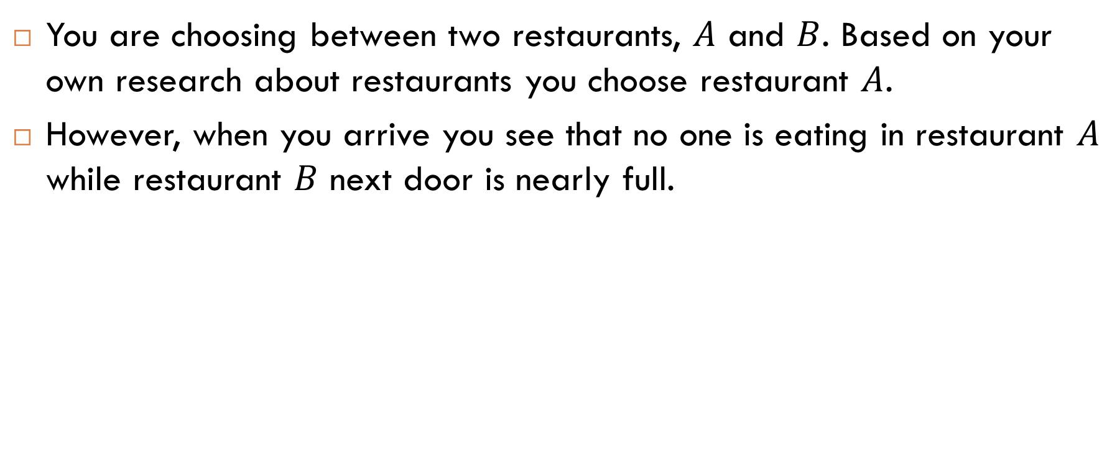
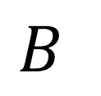
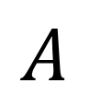
Example
You are choosing between two restaurants, $A$ and $B$. Based on your own research about restaurants you choose restaurant $A$.
However, when you arrive you see that no one is eating in restaurant $A$ while restaurant $B$ next door is nearly full.
$$A$$
$$B$$

Slide 24
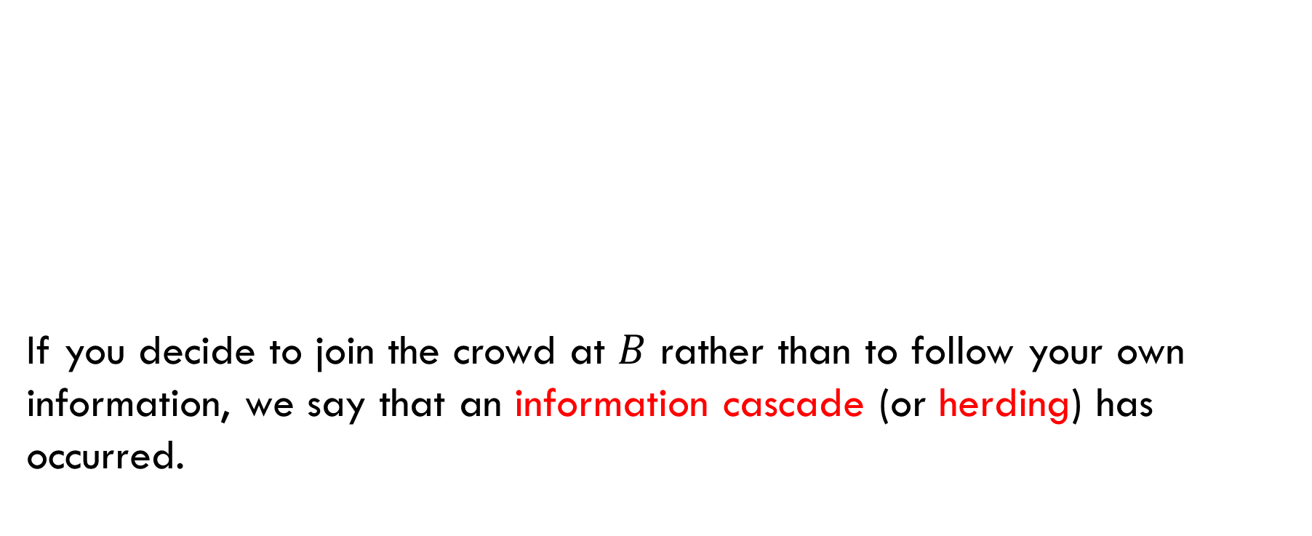
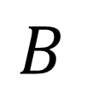
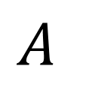
Information Cascade
If you decide to join the crowd at $B$ rather than to follow your own information, we say that an information cascade (or herding) has occurred.
$$A$$
$$B$$

Slide 25
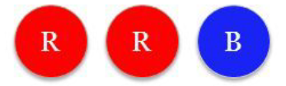
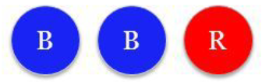
Herding Experiment: Setup
Participants: a group of students.
Place: classroom.
Equipment
There are two urns:
the majority-red urn with two red balls and one blue ball
the majority-blue urn with two blue balls and one red ball

Slide 26
Experiment
One of the two urns is selected at random and this is the urn used in the experiment.
Each student comes to the front of the room and draws a ball from the urn.
The student looks at the color and then places it back in the urn without showing it to the rest of the class.
The student then guesses whether the urn is majority-red or majority-blue and publicly announces this guess to the class.

Slide 27
Informal Analysis: The First Two Students
First student. Let Alice be the first student, what will be her guess?
If she sees a red ball, it is natural to guess that the urn is majority-red.
Otherwise, if she sees a blue ball, it is better to guess that the urn is majority-blue.
Second student. Let Bob be the second student, what will be his guess?
If he sees the same color as Alice, then he guesses this color as well.
Otherwise, he is indifferent about which guess to make. It is natural to assume that he breaks the tie by guessing the color he saw.

Slide 28

Informal Analysis: The Third Student
Let Carol be the third student, what will be her guess?
If Alice and Bob have guessed opposite colors, then it is natural for Carol to break the tie by guessing the color she saw.
Suppose the first two guesses have been the same – say, they have both been “blue”. If Carol draws a blue ball, her guess is “blue”. What will be her guess if she draws a red ball?
Alice: “blue”
Bob: “blue”
Carol:

Slide 29
Informal Analysis: Carol’s Reasoning
Since both Alice and Bob have guessed “blue”, Carol can reason in this case as though she saw three draws from the urn: two blue balls and one red ball. Given this information, Carol should guess that the urn is majority-blue, though her private information suggested that the urn is majority-red.
Key point. When the first two guesses are the same, Carol guesses this color as well, regardless of which color she draws from the urn.
Alice: “blue”
Bob: “blue”
Carol: “blue”

Slide 30
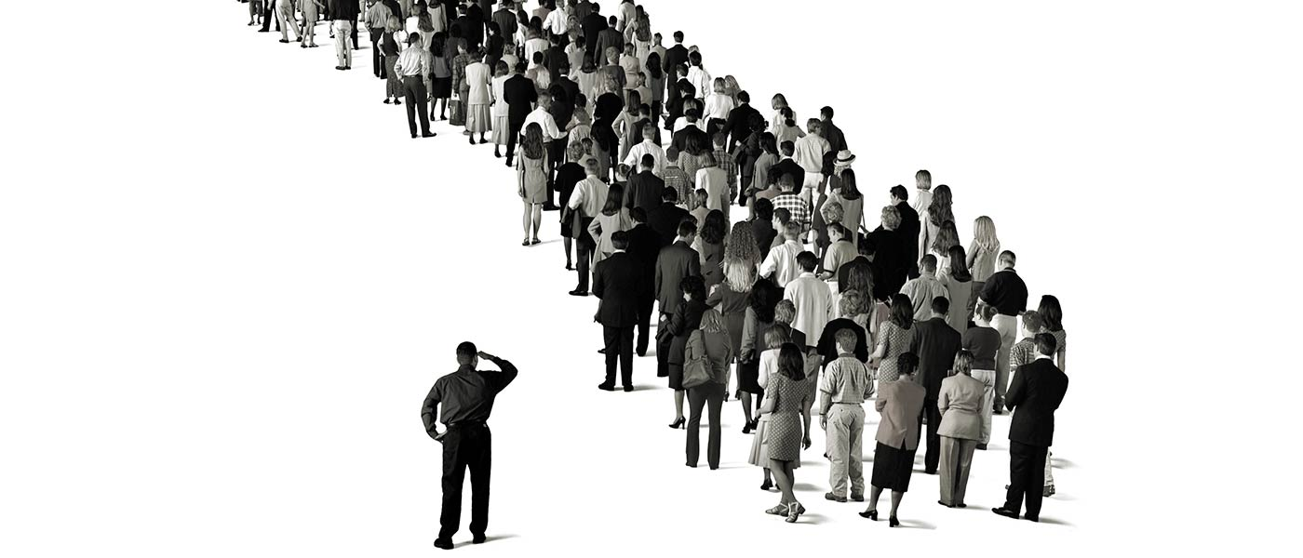
Information Cascade
Fourth and next students. Other students are in the same situation (for making a decision) as Carol: whichever colors they draw, they should guess “blue” regardless of what they see.
Beginning with Carol, an information cascade has begun: she makes the same guess as Alice and Bob, regardless of her own private information.

Slide 31
Lessons from Cascades
Cascades can be wrong. For example, what is the probability that a cascade in the herding experiment is wrong?
More information is needed. When taking into account the previous decisions, you need to have more information about why these decisions were made. For example, the fourth student needs to know not only Carol’s decision “blue”, but also the fact that she drew a red ball.
Cascades are fragile. Suppose a cascade of “blue” is under way. This cascade stops if only few subsequent students change their decisions (for example, after learning the colors of balls drawn previously).

Slide 32
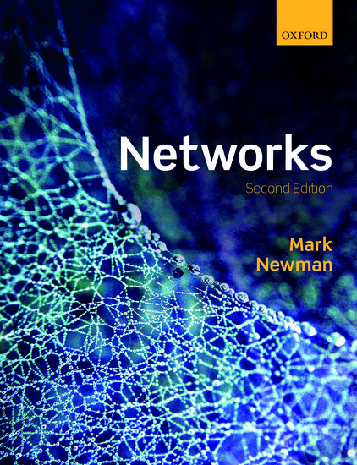
Reading
Sections 13.1-13.2, 13.5

